Slide 1


Oral Communication Skills B
(CELEN082)
Lesson 6.2

Slide 2
Lesson aims and objectives
Increase awareness of and practise presenting the content typically required in a conclusion to an oral presentation. Identify and practise using signposting language used in a conclusion.

Slide 3

Getting started

Slide 4

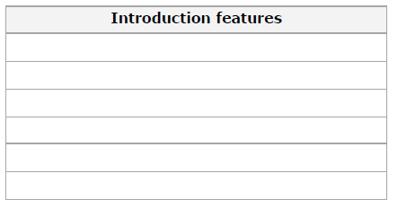
Getting started
In our previous lesson, we studied the features that are typically included in an introduction to an academic presentation.
In your group, write down a list of as many of these as you can remember.
Introduction features
A greeting
A self-introduction
An ‘attention grabber’
A link from the ‘attention grabber’ to your topic
A statement about the topic
An overview of the presentation content
Conclusion features
Based on your homework, write down a list of the features you think are needed in a conclusion.

Slide 5
Getting started
Based on the list you created, …
circle the features that all your group have included in your own conclusions.
underline the features that only some of you have included.

Slide 6
Conclusions
(Content)

Slide 7
Conclusions: Content
Watch an experienced speaker present a conclusion and complete the tasks below:
Use the list you created in the previous activity and tick [✓] the features in your list that the speaker includes.
Write down any extra features in the conclusion that you did not include in your list.
Conclusion features
1. Signal the final stage of the presentation
2. Summary of main points
3. Clincher
4. Thank the audience
5. Reference list

Slide 8
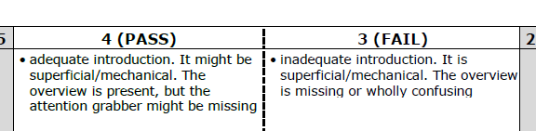

Conclusions: Summary
Providing a summary at the end of your presentation helps the audience remember the main points that you discussed. Therefore, it is a key element of the conclusion.
In the Final Presentation, you must include a summary in your conclusion, or you will fail in the Task achievement criteria.

Slide 9
Conclusions
(Clincher)

Slide 10

Conclusions: Clincher
An effective speaker will use a clincher at the end of a presentation. The purpose of the clincher is to leave the audience with a strong message.
What do you think a *clincher is?
What do you think is its purpose?
Conclusion features
1. Signal the final stage of the presentation
2. Summary of main points
3. Clincher*
4. Thank the audience
5. Reference list
In the Final Presentation, you will be assessed on the effectiveness of your clincher.

Slide 11
Conclusions: Clincher
Read the three sample clinchers below, and match them to the type of message employed by the speaker.
OK, I’d like to finish by pointing out that, as these two solutions demonstrate, tackling the problem of obesity will require action from the government, local communities and individuals. So, if we’re to live healthier and longer lives, we must work together.
A warning
A
A call
for action
OK, I’d like to finish by pointing out that tackling the problem of obesity is vital in order to decrease the risk of health conditions that can seriously impact life quality and can even be fatal!
B
OK, I’d like to finish by pointing out that although it is the responsibility of both governments and local communities to take action to tackle the causes of obesity, it is our personal choices that can have the most impact. As individuals, we should pay attention to our diet and lifestyle.
Highlight
a shared responsibility
C
Which type of message do you think would work for your own presentation topic?

Slide 12
Conclusions
(Language)

Slide 13
Conclusions: Language
Watch the experienced speaker present the conclusion again and listen for the signposting phrases.
Pay attention to the six underlined sections of text. Each one contains a mistake (i.e. a missing or incorrect word, or an extra word). Listen and fix them.​
OK, so that takes us to the end (1) of my presentation. Before I finish, let me get through (2) my main points again. I outlined (3) the problem of obesity in the UK and suggested two solutions. Both come with challenges and yet are highly practical. Introducing a ban on sugar-sweetened drinks is certainly achievable, would take immediate effect, and similar bans have been proven to lead to a reduction in the purchase of unhealthy products. Similarly, increasing physical activity in daily life through government supported campaigns in local communities has been shown to have a significant impact on obesity and would likely be successful in the UK. OK, I like to finish by (4) pointing out that, as these two solutions demonstrate, tackling the problem of obesity will require action from the government, local communities and individuals. So, if we’re to live healthier and longer lives, we must work together. Thank you for your listening (5). Here’s my sources list (6).
brings
run
‘ve outlined
I’d
your
reference

Slide 14
Conclusions: Language
Analyse the underlined signposting phrases from the sample conclusion and match them to the function they perform.
Thanking the audience
Introducing the reference list
Signposting the summary of the main ideas
Signposting a ‘clincher’ (a way to end your presentation strongly by reinforcing your main idea).
Signposting the conclusion
E
OK, so that brings us to the end (1) of my presentation. Before I finish, let me run through (2) my main points again. I’ve outlined (3) the problem of obesity in the UK and suggested two solutions. Both come with challenges and yet are highly practical. Introducing a ban on sugar-sweetened drinks is certainly achievable, would take immediate effect, and similar bans have been proven to lead to a reduction in the purchase of unhealthy products. Similarly, increasing physical activity in daily life through government supported campaigns in local communities has been shown to have a significant impact on obesity and would likely be successful in the UK. OK, I’d like to finish by (4) pointing out that, as these two solutions demonstrate, tackling the problem of obesity will require action from the government, local communities and individuals. So, if we’re to live healthier and longer lives, we must work together. Thank you for listening (5). Here’s my reference list (6).
C
C
D
A
B

Slide 15
Conclusions: Language
Analyse the additional phrases on the right and match them to their function.
Thanking the audience
Introducing the reference list
Signposting the summary of the main ideas
Signposting a ‘clincher’ (a way to end your presentation strongly by reinforcing your main idea).
Signposting the conclusion
D
1. Let me end by VERB-ing …
2. Let me remind you of the main points I’ve covered today.
C
3. So let’s sum up what we’ve talked about today.
C
D
4. I’d like to close by VERB-ing …
5. OK. So we’ve now come to the end of my presentation.
E

Slide 16
Independent practice

Slide 17
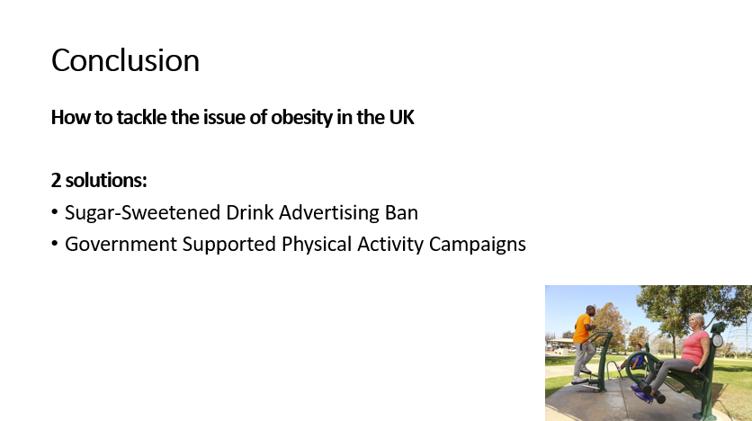
Practice
Using the conclusion that you prepared for homework and what you’ve learnt in today’s class, complete the following tasks:
Make improvements to your conclusion e.g. add missing content, improve your signposting etc.​
Present your conclusion to a partner. Your partner will film you.​
Watch your video. Are you happy with your conclusion?
You should include a PowerPoint slide in your presentation showing your main points.

Slide 18
Homework
Due | Task
Lesson 7.1 | Lesson 7.1 focuses on PowerPoint for presentations. Read Appendix 2: PowerPoint Slides information section from the OCSb Module Handbook. Download and read the OCSb 24-25 PowerPoint Slides (MARKING CRITERIA) document from the Assessment section on Moodle. Create a draft of all of the PPT slides for your Final Presentation. Bring the slides to class.
Reminder:
You will need to submit your Final Presentation slides for the PPT Slides assessment via the Submission Box on Moodle by Monday 7th April, 3pm (Week 8).

